Slide 1
Week 8
Intro to Machine Learning, Clustering, and Dimensionality Reduction

Slide 2
Today’s Agenda
What is Machine Learning?
Supervised Learning
Unsupervised Learning
Uses of clustering
Unsupervised Learning: Dimensionality Reduction

Slide 3
What is Machine Learning?
What is the learning part of machine learning?

Slide 4
What is Machine Learning?
What is the learning part of machine learning?
When we can create a model that has tunable parameters, i.e. these parameters can change based on the input datasets

Slide 5
What is Machine Learning?
Why do we want these models?

Slide 6
What is Machine Learning?
Why do we want these models?
In machine learning, different than in applied statistics, we are less interested in what these parameters are, and more in how well they can
Make predictions
Describe underlying structures or characteristic in the data

Slide 7
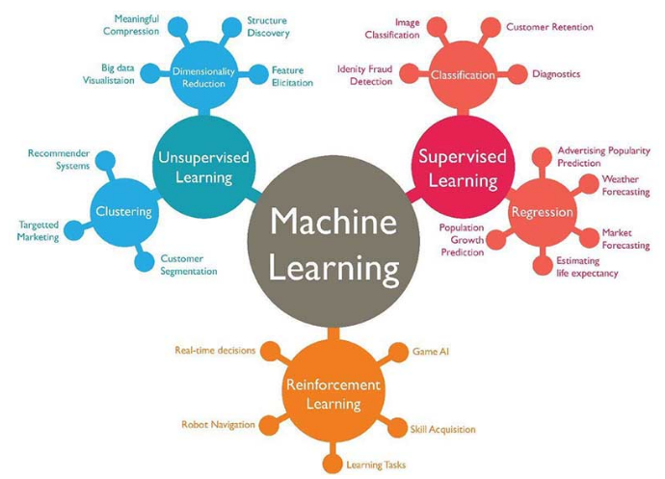
Categories of Machine Learning
Supervised learning: Associating features with some label. This is then divided into:
Classification: labels as discrete categories
Regression: labels as continuous quantities.

Slide 8
Categories of Machine Learning
Supervised learning: Associating features with some label. This is then divided into:
Classification: labels as discrete categories
Regression: labels as continuous quantities.
Unsupervised learning: Modeling the features of the dataset without labels. Often such methods as:
Clustering: identifying groups of data
Dimensionality reduction: succinct representation

Slide 9
Categories of Machine Learning
Let’s look at some examples

Slide 10
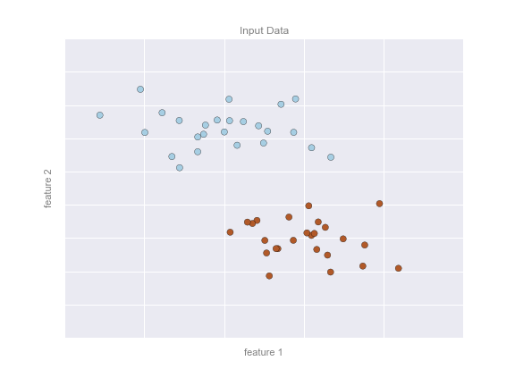
Supervised learning: Classification
Let’s look at some examples

Slide 11
Supervised learning: Classification
Let’s look at some examples
Here, we have a two-dimensional (read: two columns) dataset
We know which dots are blue and which are red.

Slide 12
Supervised learning: Classification
Let’s look at some examples
Here, we have a two-dimensional (read: two columns) dataset
We know which dots are blue and which are red.
The classification question then asks:
Can we create a “separator” model that separates these two points?

Slide 13
Supervised learning: Classification
Model: the quantitative version of “there is a straight line that can separate the two classes”.
Parameters: the intercept and axis (or however else we want to define our line) that describes the line

Slide 14
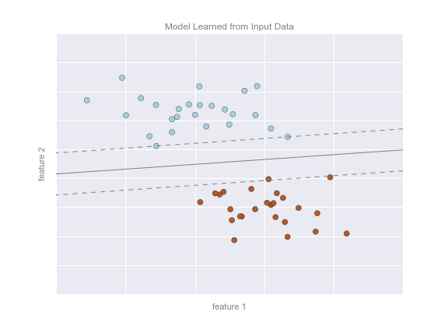
Supervised learning: Classification
So our model could look like this on the right.
By the way, this is a support vector machine classifier. Any guesses how this line is being created?

Slide 15
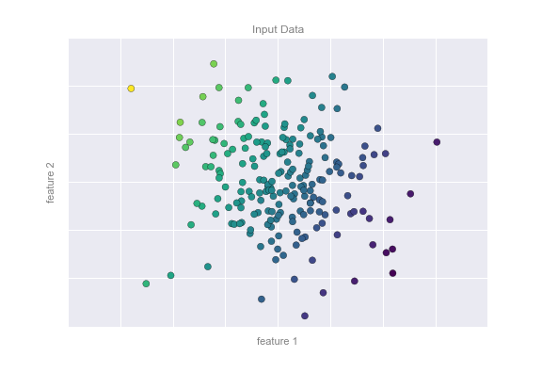
Supervised learning: Regression
(This one is a little trickier to visualize)
Imagine that we now have the same two columns, except our labels are continuous.

Slide 16
Supervised learning: Regression
(This one is a little trickier to visualize)
Imagine that we now have the same two columns, except our labels are continuous.

Slide 17
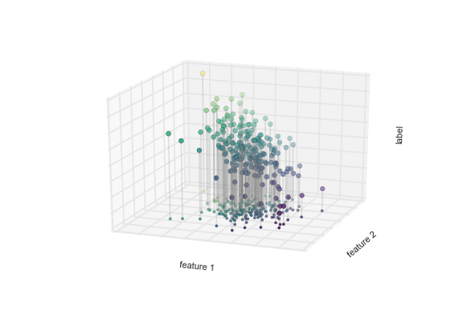
Supervised learning: Regression
On the X-Y axes, we typically see one independent variable that predicts a dependent variable.
We can typically find a line (1-D) that we can draw, which traces a pattern.
Since we now have two independent variables that predict a dependent variable, we’ll need to draw a plane (2-D) .

Slide 18
Supervised learning: Regression
So we want to find a plane that cuts through these points.

Slide 19
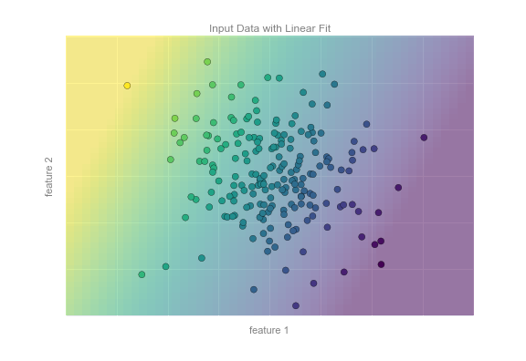
Supervised learning: Regression
This is the plane in 2D.

Slide 20
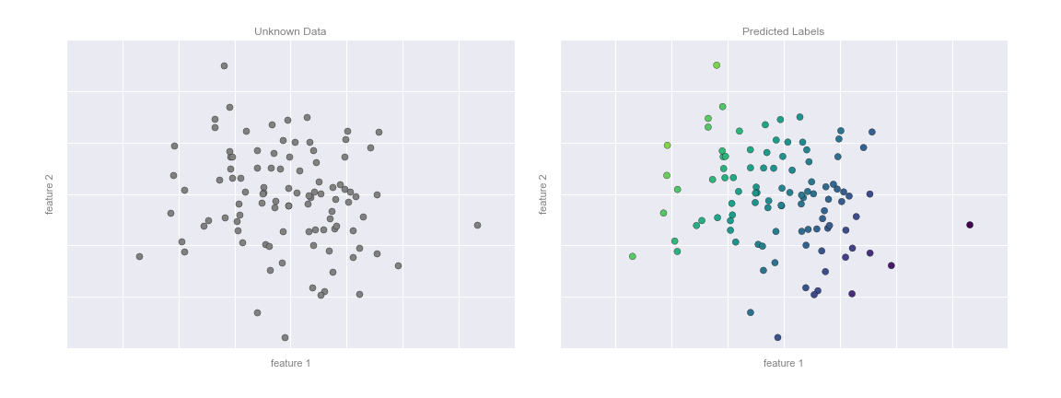
Supervised learning: Regression
This is the plane.

Slide 21
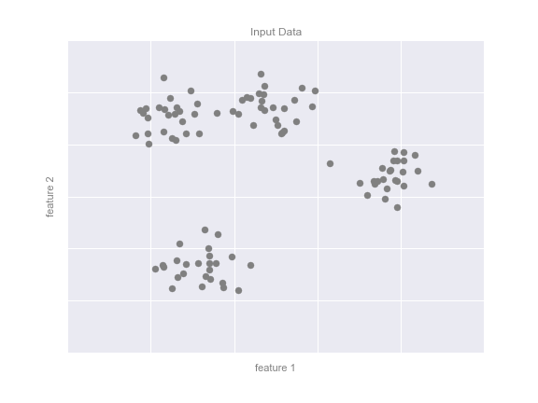
Unsupervised learning: Clustering
Imagine we had a dataset with two features (i.e. columns) that looked like this when we mapped the two.
We can visually see that there are some groups that seem to appear here.
How do we take advantage of some inherent characteristics of the data…

Slide 22
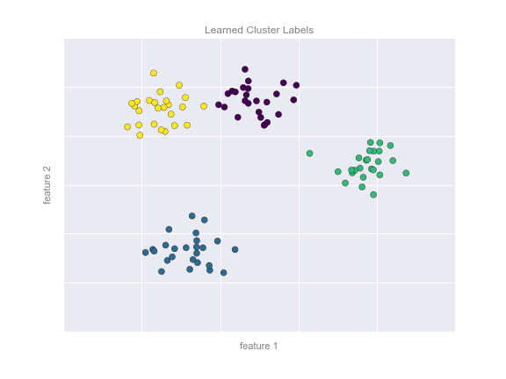
Unsupervised learning: Clustering
… to create something like this.
This has been created by an unsupervised ML algorithm called k-means.
k-means fits a model consisting of k cluster centers; the optimal centers are assumed to be those that minimize the distance of each point from its assigned center.

Slide 23
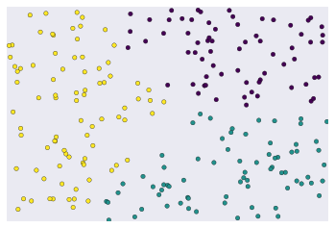
What is Clustering
Clustering is the meaningful creation of groups or collections
It is the grouping of unlabeled data.

Slide 24
What is Clustering
If these data were actually labeled, then clustering becomes classification

Slide 25
What is Clustering
How do we create these groups?
We need to define some measure of similarity

Slide 26

What is Clustering
How do we determine similarity?
If we only had one or two features, it might be easy to define.
For ex: Say we are trying to classify books and we have author names only

Slide 27
What is Clustering
The most straightforward way to classify these books by author

Slide 28
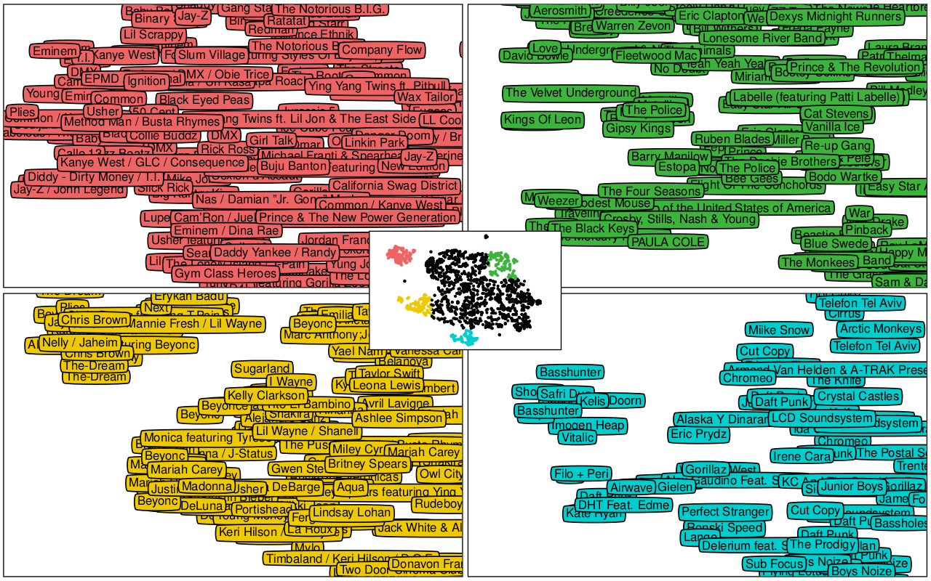
What is Clustering
As we get more features, however, the definition of what is similarity can be more tricky.
It also depends on how we want to think about similarity

Slide 29
What is Clustering
For ex: this is a Spotify classification of different musical artists.
The closer in distance these names are on the chart, the more similar they are.
This list, however, is created by hundreds of features

Slide 30
What are the uses of clustering?
As clustering is a tool that can be used across different sectors, as long as there is data, it has a wide range of applications.

Slide 31
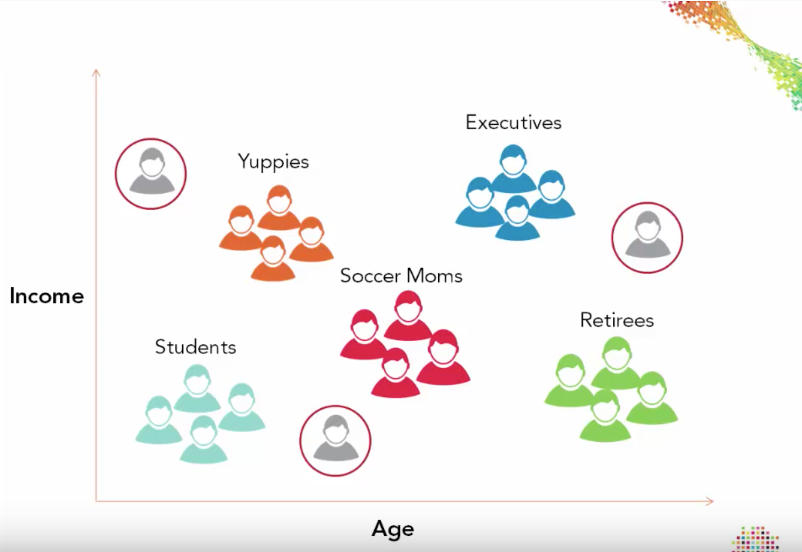
What are the uses of clustering?
For ex: market segmentation
Using customer data to understand different types of users.

Slide 32
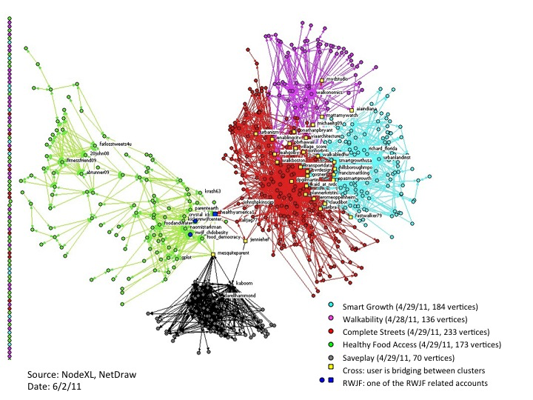
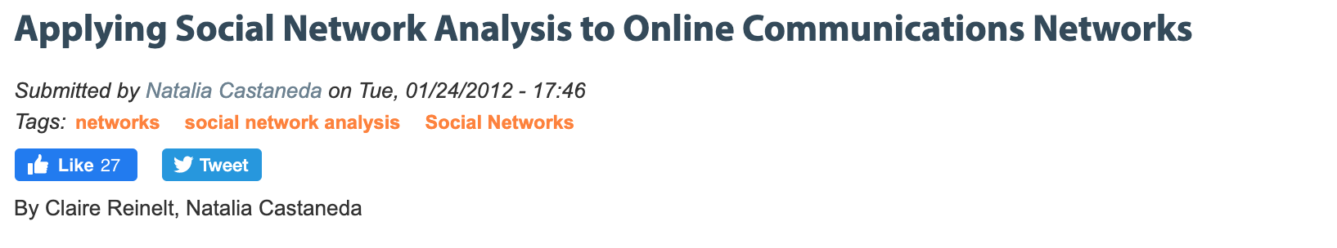
What are the uses of clustering?
For ex: social network analysis
This is clustering of Twitter conversations online

Slide 33
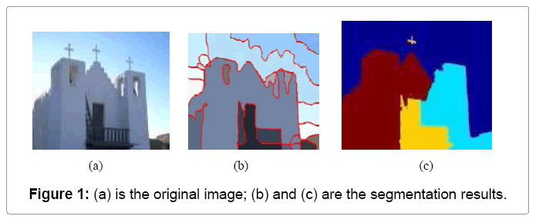
What are the uses of clustering?
For ex: image segmentation
Clustering can be used to group pixels

Slide 34

What are the uses of clustering?
For ex: image segmentation
Guess what we use for autonomous vehicles to detect objects in space?

Slide 35
Different types of clustering algorithms
Centroid-based clustering
Density-based clustering
Distribution based clustering

Slide 36
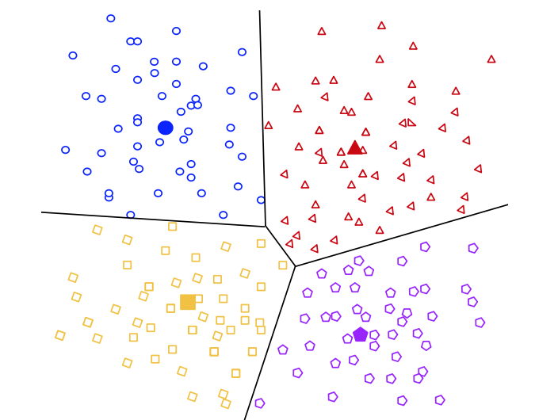
Centroid-based clustering
Based on the image on the right, what do you think centroid-based clustering is?

Slide 37
Centroid-based clustering
The similarity measure is defined by the centroid
Distance is each point to its nearest centroid tells us how well we are fitting the data
All points are assigned to a cluster
For ex: K-means

Slide 38
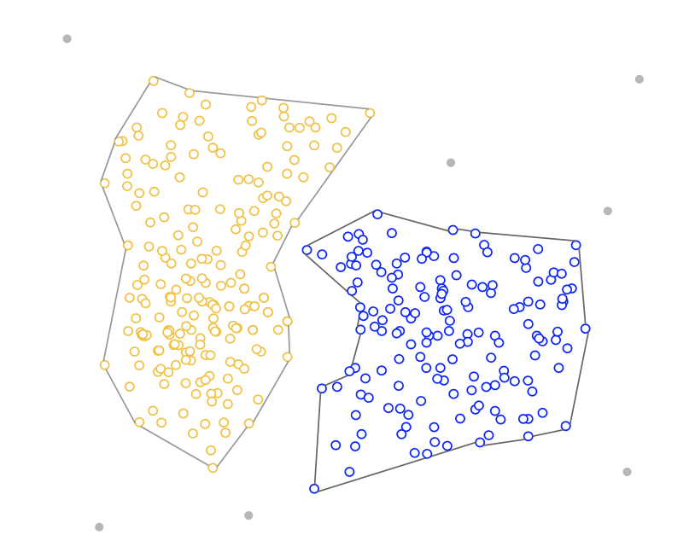
Density-based clustering
Based on the image on the right, what do you think density-based clustering is?

Slide 39
Density-based clustering
Another method that is not based on distance, but how many other points are around each point
The similarity measure is based on connections to my neighbors or lack thereof
This allows us to make clusters of arbitrary shapes
Not all points need to be assigned to a cluster (if it’s an outlier
For ex: DBSCAN

Slide 40

Density-based clustering
This is a good GIF of how DBSACAN works

Slide 41
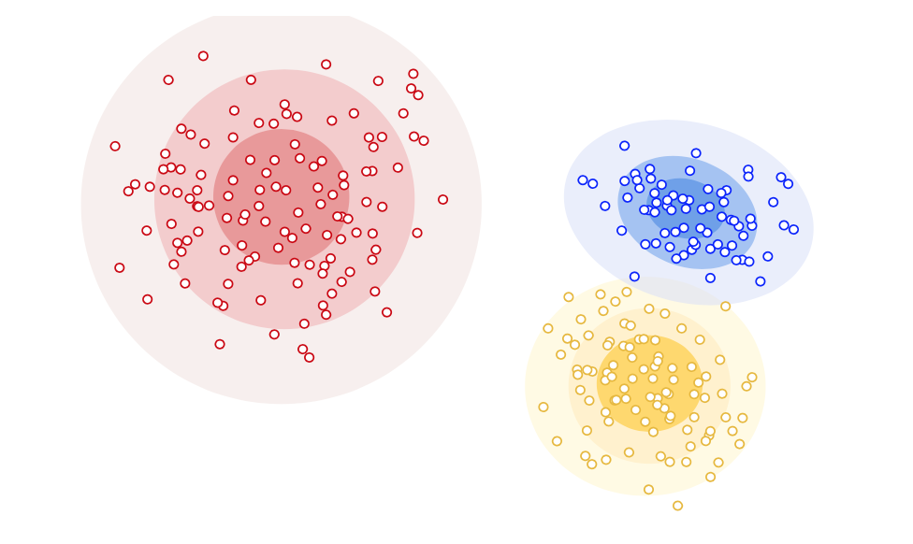
Distribution-based clustering
Based on the image on the right, what do you think distribution-based clustering is?

Slide 42
Distribution-based clustering
Assumes that points fall along one or several (typically normal) distributions.
As the distance from the distribution’s center increase, the probability that the point belongs to that distribution decreases.
For ex: expectation maximization

Slide 43
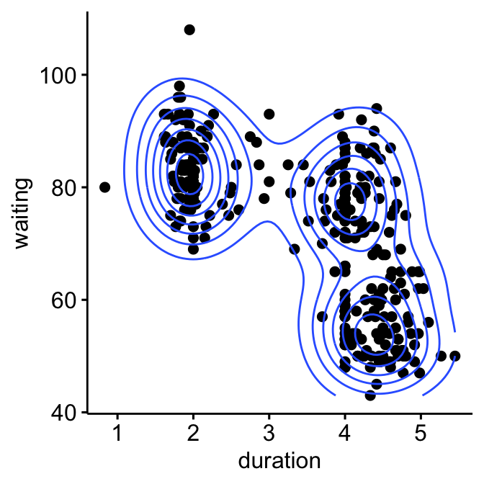
Distribution-based clustering
This chart is from a dataset of Old Faithful’s geyser eruptions
It shows waiting time between eruptions and the duration of each eruption
The three distinct clusters could be three different periods of geyser activity
Why is that?

Slide 44
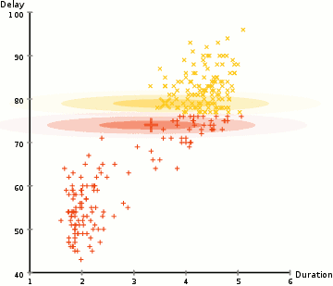
Distribution-based clustering
This is an animation of how the expectation-maximization algorithm works

Slide 45
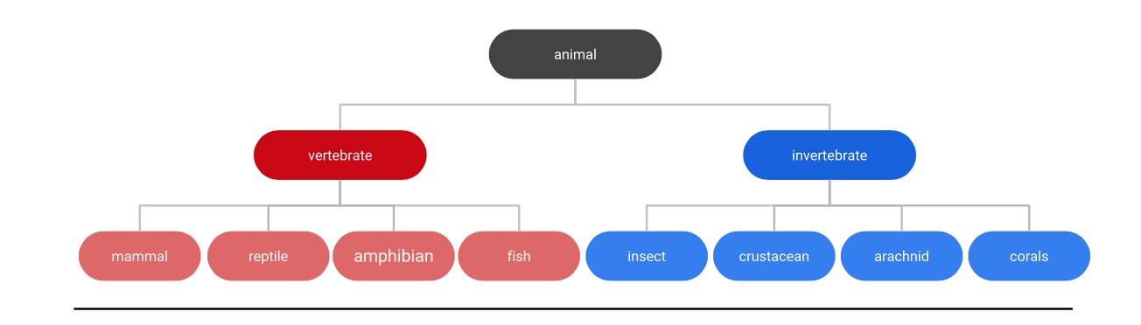
Hierarchical clustering
Based on this image below, what do you think hierarchical clustering is?

Slide 46
Hierarchical clustering
Hierarchical clustering creates trees of clusters.
It’s best of data that is hierarchical
Depending on where you cut the branches, you can more or fewer clusters

Slide 47

Hierarchical clustering
This is an animation of how hierarchical clustering works

Slide 48
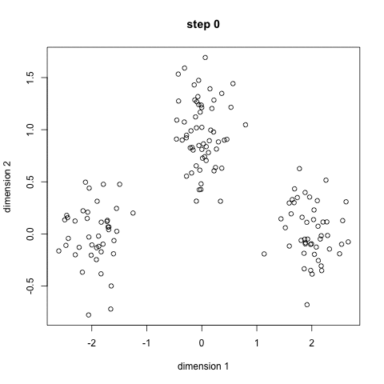
K-Means Clustering
Take a look at this animation and see if you can guess how K-Means clustering works

Slide 49
K-Means Clustering
Here are the steps to a K-means algorithm:
Select the number of groups you want to create
To figure this out, you may want to do a quick plot of the data to see if you can eyeball the number of distinct groups

Slide 50
K-Means Clustering
Here are the steps to a K-means algorithm:
Select the number of groups you want to create
To initialize the algorithm, Sklearn will either randomly select three centers, or you can also input three centers

Slide 51
K-Means Clustering
Here are the steps to a K-means algorithm:
Select the number of groups you want to create
Each point is given a label based on which center it’s closest to

Slide 52
K-Means Clustering
Here are the steps to a K-means algorithm:
Select the number of groups you want to create
Each point is given a label based on which center it’s closest to
Based on these initial groups, the centroids are recalculated

Slide 53
K-Means Clustering
Here are the steps to a K-means algorithm:
Select the number of groups you want to create
Each point is given a label based on which center it’s closest to
Based on these initial groups, the centroids are recalculated
Repeat steps 1-3 until the centroids don’t seem to change that much anymore

Slide 54
K-Means Clustering
What are the advantages and disadvantages of this algorithm?

Slide 55
K-Means Clustering
What are the advantages and disadvantages of this algorithm?
Advantages
It’s pretty fast!
Disadvantages
You have to select the # of groups (what if you’re wrong on the #?)
Because the centroids are randomly selected, you can get different results based on where you initialized your centroids

Slide 56
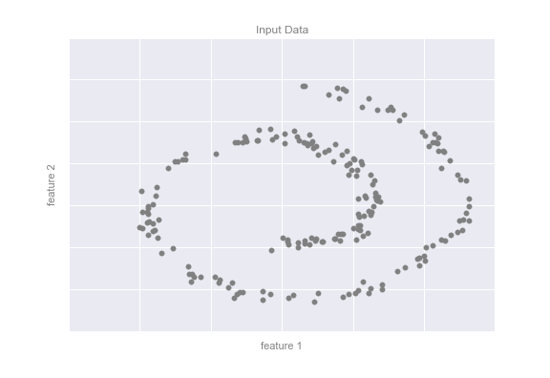
Unsupervised learning: Dimensionality Reduction
This is also a trickier concept
The “dimensionality”: This means that, rather than having and X with many (often hundreds!) of columns, we can somehow transform this into fewer columns (the dimensions).

Slide 57
Unsupervised learning: Dimensionality Reduction
This is also a trickier concept
The “dimensionality”: This means that, rather than having and X with many (often hundreds!) of columns, we can somehow transform this into fewer columns (the dimensions).
For ex: the 2-D data on the right clearly has some “structure” that is less than 2-D

Slide 58
Unsupervised learning: Dimensionality Reduction
This is also a trickier concept
The “dimensionality”: This means that, rather than having and X with many (often hundreds!) of columns, we can somehow transform this into fewer columns (the dimensions).
For ex: the 2-D data on the right clearly has some “structure” that is less than 2-D
I can draw a 1-D spiral line through these points, for example

Slide 59
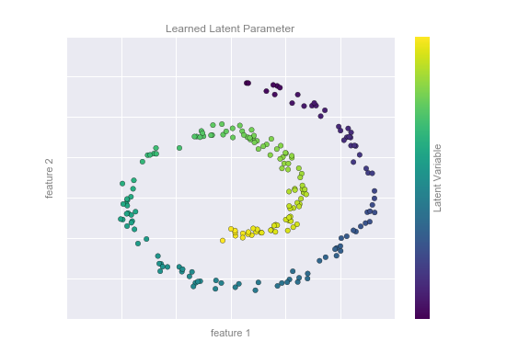
Unsupervised learning: Dimensionality Reduction
Imagine I could find some function where:
latent-variable = f(feature-1, feature-2)
In other words, I have a new 1-D variable that describes the characteristics of the two previous columns, but “collapses” them.

Slide 60
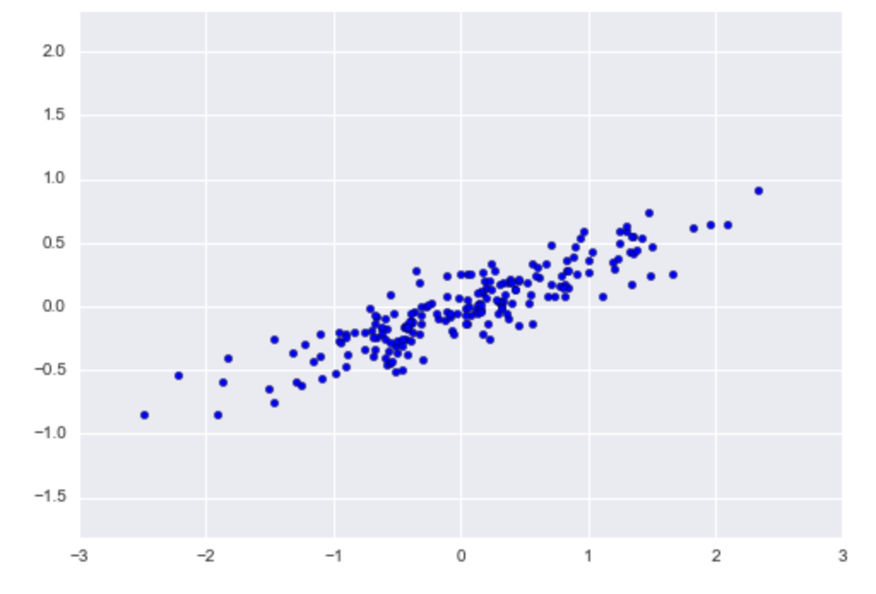
Dimensionality Reduction: Principal Component Analysis
Can we describe this dataset using a few principal “axes”?

Slide 61
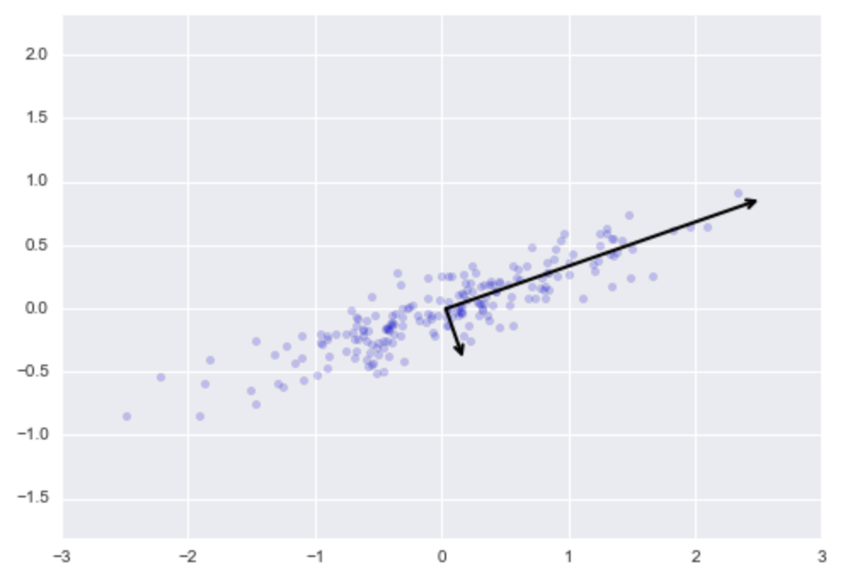
Dimensionality Reduction: Principal Component Analysis
Can we describe this dataset using a few principal “axes”?
The length of the two vectors describe how “important” each is and which directions the data vary.

Slide 62
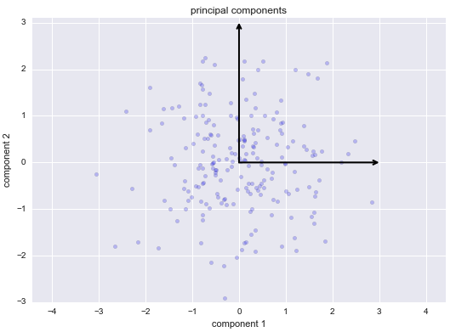
Dimensionality Reduction: Principal Component Analysis
Can we describe this dataset using a few principal “axes”?
The length of the two vectors describe how “important” each is and which directions the data vary.
After we “rotate” and “stretch” the data along their principal components

